Slide 1


Teaching Embedded Systems with Drones
Sean Cashman, Steven Ferrarese, Atheer Oufi, Spencer Goulette, Yifeng Zhu
University of Maine
Marco De Fazio, Giorgio Mariano
STMicroelectronics, Geneva, Switzerland
ASEE 2019

Slide 2
Role of Embedded Systems: Lays foundation
Laying foundation in curriculum:
  Computer organization & architecture
  Operating systems
  Software design & algorithms
  Senior project design
Body of Knowledge (IEEE/ACM Computer Engineering Curricula 2016)
  Number systems and data encoding
  Instruction set architecture
  Relevant tools, standards and/or engineering constraints
  Input/output interfacing and communication
  Interrupts, timers, waveform generation
  Implementation strategies for complex embedded systems
  Computing platforms for embedded systems
Computer Organization
numbers
decoding
ISA
Interrupts
Arithmetic
Memory-mapped I/O
DMA
FPU
Embedded Systems
debugging
communication
debugging
data structure
concurrency
Software Design

Slide 3

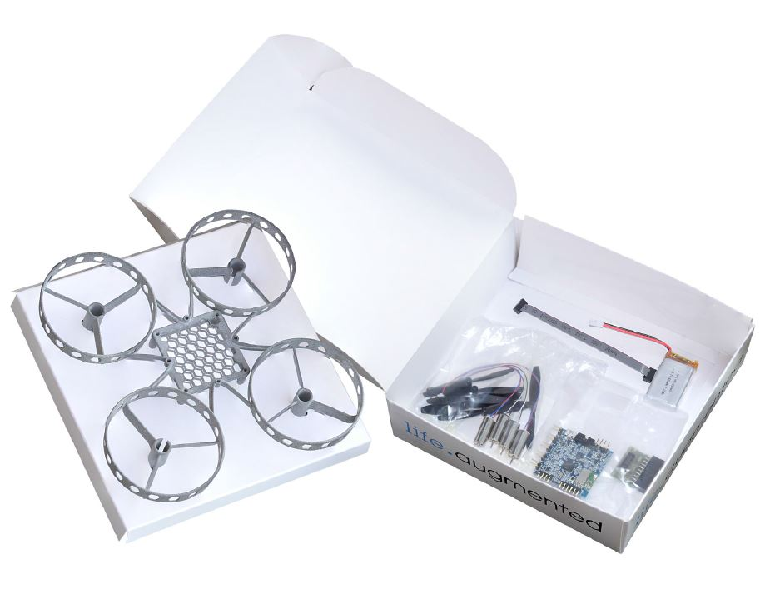



Teaching Embedded Systems with Drones:
Overview
ST Drone Kit, $50
Textbook
Lab handout, solution, and presentation

Slide 4
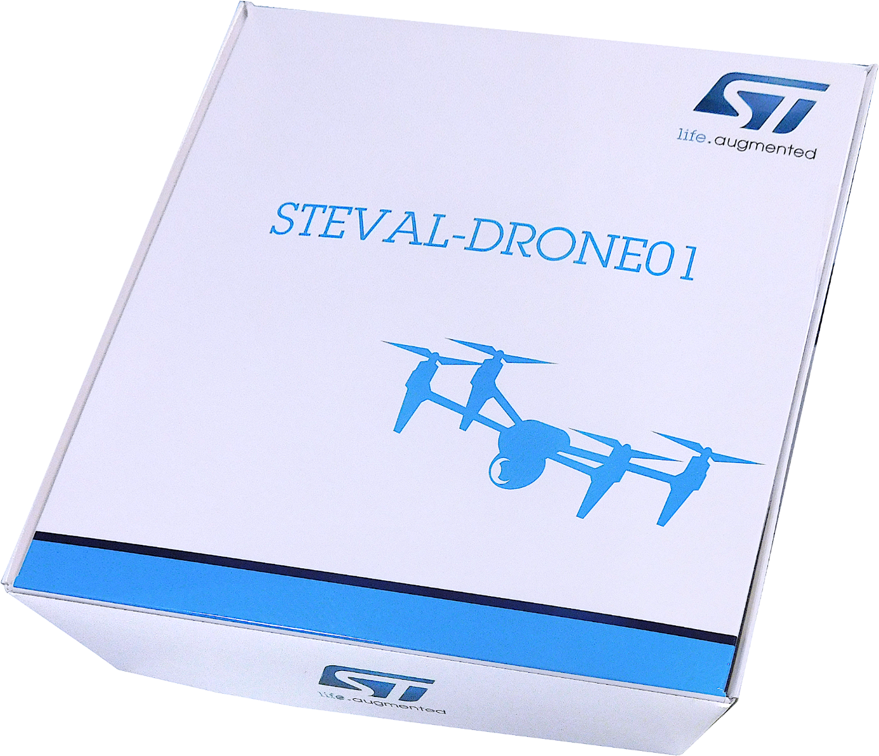
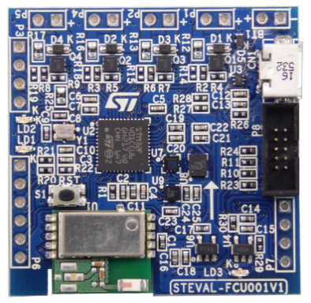
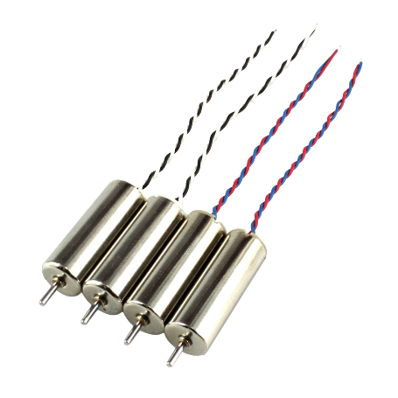
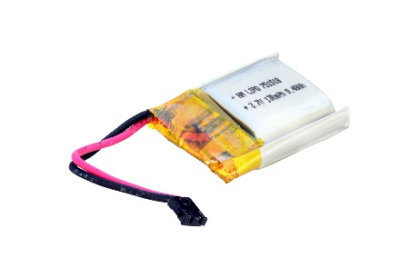
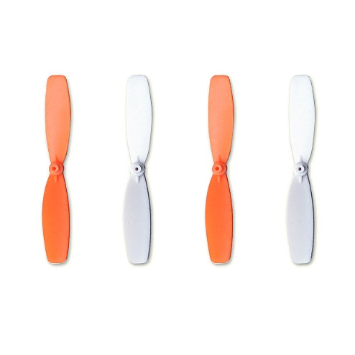
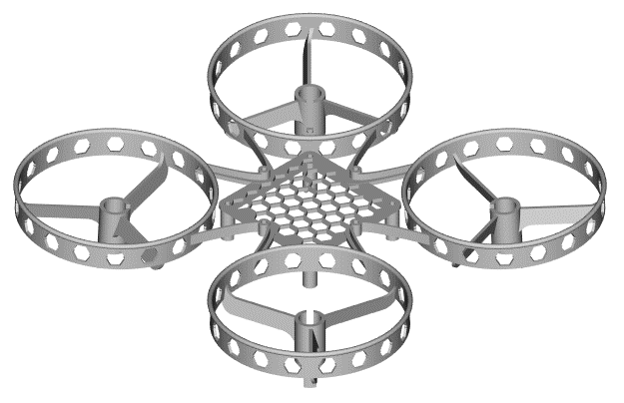
ST’s Mini Drone Kit

Slide 5
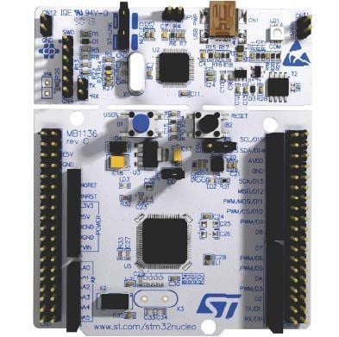
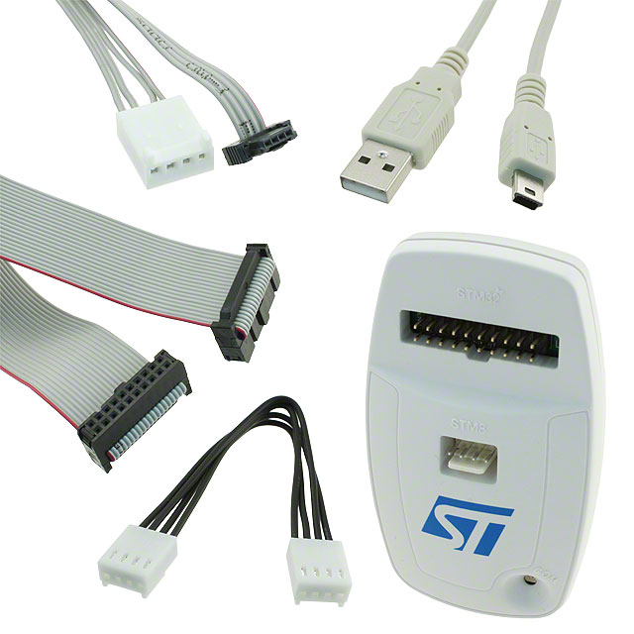
Programming & Debugger
or
ST-LINK/V2, $23
STMicroelectronics NUCLEO, $10

Slide 6
Textbook (Optional)
Complete instructor's resource:
  Lecture slides, quizzes and exams, tutorials, lab handouts and solutions (pre-lab, in-lab, and post-lab), solutions to end-of-chapter exercises
Bare-metal programming at the register level without using any API libraries
Line-by-line translation from C to ARM assembly
Strike the balance between theoretical foundations and technical practices
Using flowcharts as a reading guide for processor datasheets
Online YouTube tutorials (11.2K subscribers)
See a program running
Data representation
ARM instruction set architecture
Arithmetic and logic
Load and store
Branch and conditional execution
Structured programming
Subroutines
64-bit data processing
Mixing C and assembly
Interrupt
Fixed-point & floating-point arithmetic
Instruction encoding and decoding
General-purpose I/O
General-purpose timers
Stepper motor control
Liquid-crystal display (LCD)
Real-time clock (RTC)
Direct memory access (DMA)
Analog-to-digital converter (ADC)
Digital-to-analog converter (DAC)
Serial communication protocols
Multitasking
Digital signal processing
738 pages, $69.50

Slide 7
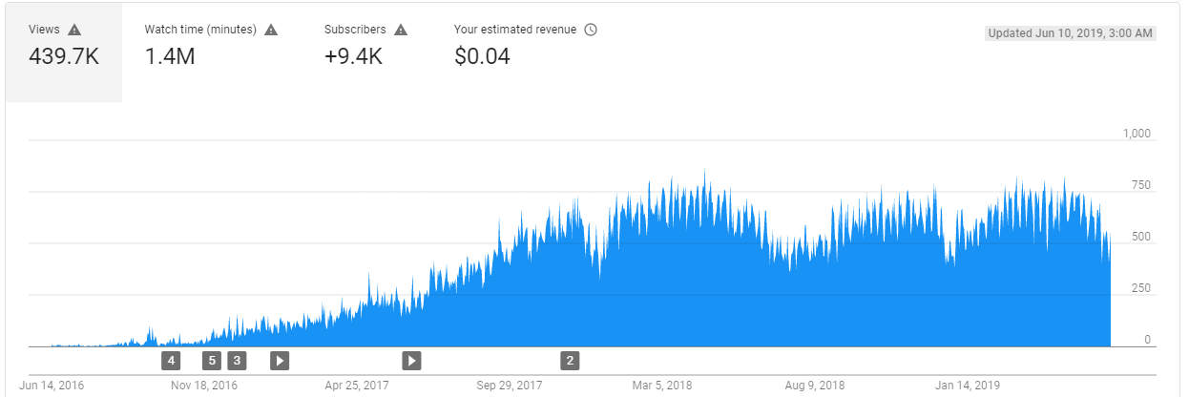
YouTube Lectures & Tutorials
https://www.youtube.com/channel/UCY0sQ9hpSR6yZobt1qOv6DA/
Tutorials
  Create a project in Keil v5
  Debugging in Keil v5
  Clock configuration of STM32L4 processors
  Printing messages via UART through ST-Link V2.1
  How to fix common errors?
Short Lectures
  Why do we use Two's Complement?
  Carry and Borrow Flag
  Overflow Flag
  Pointer
  Memory Mapped I/O
  GPIO Output: Lighting up a LED
  GPIO Input: Interfacing a joystick
  Timer: PWM output
  Interrupt Enable and Interrupt Priority
  Interrupts
  External Interrupts (EXTI)
  System Timer (SysTick)
  Booting process
  LCD
  Race Conditions

Slide 8
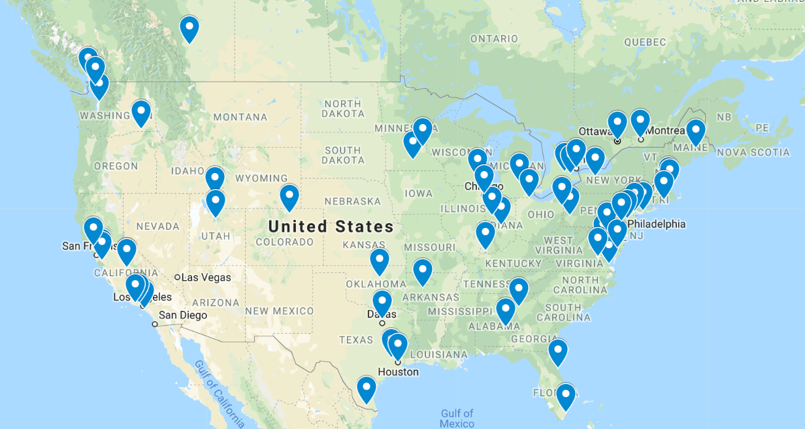
Adopted by 80+ universities in US & Canada

Slide 9
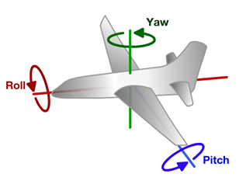
Aircraft Principal Axes
z
x
y
from wikipedia
Notes:
An aircraft in flight is free to rotate in three dimensions. Pitch, nose up or down, rotation about the y axis running from wing to wing. Roll, rotation about the x axis running from nose to tail. Yaw, nose left or right, rotation about the z axis running up and down.

Slide 10
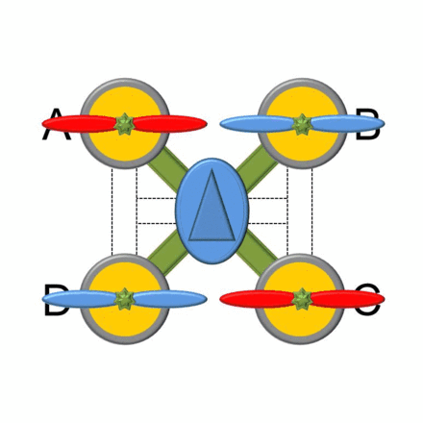
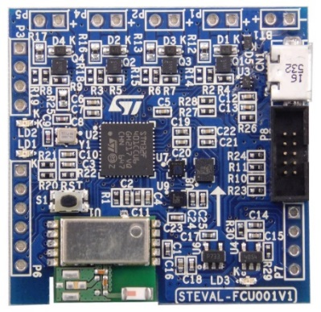
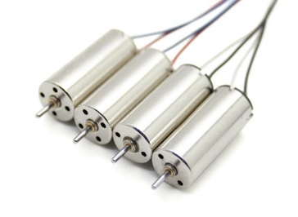
Quadcopter basics: flight control dynamics
Front direction
M2
M3
FCU
FCU: Flight Control Unit
Front Direction
M4
M1
CW: Blue(-)/Red(+)
CCW: Black(-)/White(+)
FCU: Flight Control Unit
Notes:
Two sets of rotors rotates in opposite directions.

Slide 11
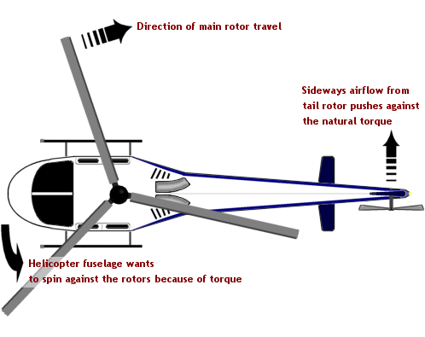
Quadcopter basics: flight control dynamics
Front direction
M2
M3
FCU
FCU: Flight Control Unit
M4
M1
Notes:
If all rotors are spinning at the same speed, with two sets of rotors rotate in opposite directions, the total torque is zero. So there is no need for a tail rotor like on conventional helicopters. If all the rotors were to spin in the same direction, it would result in a net Torque causing the complete Quad to rotate.

Slide 12
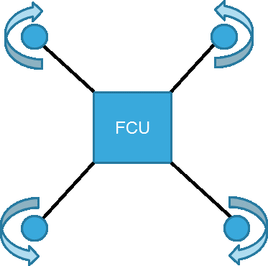
Quadcopter basics: flight control dynamics
A quadcopter hovers or adjusts its altitude by applying equal thrust to all 4 rotors.
A quadcopter adjusts its yaw by applying more thrust to rotors rotating in the same direction.
A quadcopter adjusts its pitch or roll by applying more thrust to one rotor and less thrust to its diametrically opposite rotor.

Slide 13
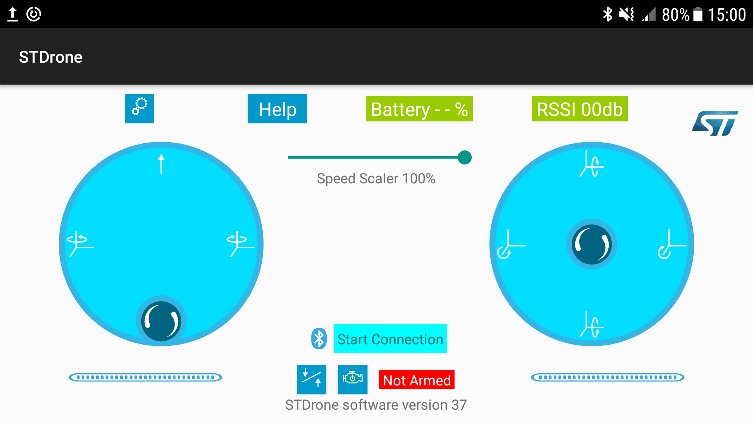
Bluetooth ST AppDrone
Button to connect to the Drone
Throttle
High
Pitch
Down
Yaw Left
Yaw Right
Roll
Left
Roll
Right
Throttle
Low
Pitch
Up
Left joystick(THR, RUD)
Right joystick (ELE,AIL)
https://github.com/STMicroelectronics-CentralLabs/ST_Drone_FCU_F401

Slide 14
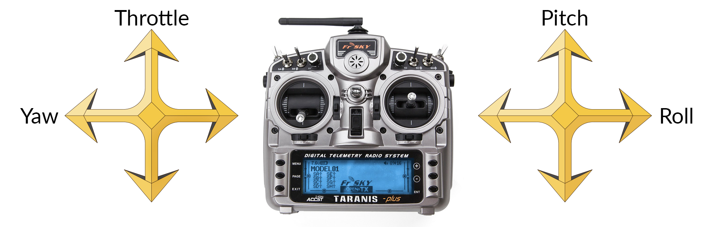
Alternate Remote Control

Slide 15

Controller
40 mm
LSM6DSL
A + G 6-axis IMU
STL6N3LLH6
Power MOSFET
LPS22HD
Pressure Sensor
LIS2MDL
Magnetometer
40 mm
SPBTLE-RF
Bluetooth Smart v4.1 Module

Slide 16
Controller

Slide 17
Controller
CN1
STC4054
LD39015
P8
M4
M2
M3
M1
LDO
3V3
SPBTLE-RF
JTAG connector
Micro USB **
Battery charger
BLE module
LiPo 1-cell battery
32-bit MCU
BT1
SPI1
USB
JTAG
LSM6DSL
A + G IMU
SPI2
TIM4 PWM out
Power MOS x4
4 x DC motor
LIS2MDL
Magnetometer
STL6N3LLH6
P1, P2, P4, P5
TIM2 input capture
PWM
Remocon RX*
LPS22HD
Pressure Sensor
P6
UART connector
UART1
I2C2
I2C connector
P7
STM32F401
P3

Slide 18
Teaching at which level?
Visual wizard tools (such as STMCubeMX)
HAL (Hardware Abstraction Layer) libraries
Bare-metal
Applications
Driver
CubeMX
Bare-metal: Bypass HAL and possibly CMSIS-Core
HAL
CMSIS-Core
Hardware

Slide 19
HAL Level
Pros
  Simplify implementation
  Better portability
  Many examples
Cons
  Very complex to understand
  Cannot meet students’ curiosity
; Initialize the Red LED pin (PB.2)
static GPIO_InitTypeDef GPIO_InitStruct;
GPIO_InitStruct.Mode = GPIO_MODE_OUTPUT_PP;
GPIO_InitStruct.Pull = GPIO_PULLUP;
GPIO_InitStruct.Speed = GPIO_SPEED_FREQ_VERY_HIGH;
GPIO_InitStruct.Pin = GPIO_PIN_2;
HAL_GPIO_Init(GPIOB, &GPIO_InitStruct);
HAL_GPIO_TogglePin(LED4_GPIO_PORT, LED4_PIN);
void HAL_GPIO_Init(GPIO_TypeDef *GPIOx, GPIO_InitTypeDef *GPIO_Init){
uint32_t position = 0x00;
uint32_t iocurrent = 0x00;
uint32_t temp = 0x00;
...
}
130
lines

Slide 20
Bare-Metal Level in C
#define LED_PIN 2
// GPIO Mode: Input(00), Output(01), AlterFunc(10), Analog(11, reset)
GPIOB->MODER &= ~(3<<(2*LED_PIN)); // Clear by using mask
GPIOB->MODER |= 1<<(2*LED_PIN); // Set as Output
// GPIO Speed: Low speed (00), Medium speed (01), Fast speed (10), High speed (11)
GPIOB->OSPEEDR &= ~(3<<(2*LED_PIN)); // Clear by using mask
GPIOB->OSPEEDR |= 2<<(2*LED_PIN); // Fast speed
// GPIO Output Type: Output push-pull (0, reset), Output open drain (1)
GPIOB->OTYPER &= ~(1<<LED_PIN); // Push-pull
// GPIO Push-Pull: No pull-up pull-down (00), Pull-up (01), Pull-down (10), Reserved (11)
GPIOB->PUPDR &= ~(3<<(2*LED_PIN)); // No pull-up, no pull-down
// Toggle up the LED
GPIOB->ODR ^= 1 << LED_PIN;
Only 7 lines of code
Focus on directly interfacing with hardware.
Do not use any libraries!

Slide 21
Bare-Metal Level in Assembly
Bare-metal level programming helps learning assembly programming
Set Pin B.2 as GPIO output
#define LED_PIN 2
// GPIO Mode: Input(00), Output(01), AlterFunc(10), Analog(11, reset)
GPIOB->MODER &= ~(3<<(2*LED_PIN));
GPIOB->MODER |= 1<<(2*LED_PIN); // Output(01)
C implementation
Translate naturally
LED_PIN EQU 2
LDR r0, =GPIOB_BASE
LDR r1, [r0, #GPIO_MODER]
EOR r1, r1, #(0x03<<(2*LED_PIN))
ORR r1, r1, #(1<<LED_PIN)
STR r1, [r0, #GPIO_MODER]
Assembly implementation

Slide 22
Eight lab modules for drones
Remote Control
Flight Control
Motors
Register-level Programming
  PWM output
  UART
  ADC
  SPI
Concept-level Understanding
  AHRS
  PID
  BLE
Application-level Programming
  Flying
Sensor Management
AHRS
PID Control
Utilities
Application
BLE stack
USB Virtual COM
CMSIS
Middleware
Board Support Package
STM32Cube Hardware Abstraction Layer (HAL)
Components Support Package
Drivers
LSM6DSM
LISM2DL
STM32F4
HW components
LPS22HD
BLUENRG-MS
STEVAL-FCU001V1
Development board
Module not yet implemented in current FW implementation
Each lab is independent from each other.

Slide 23
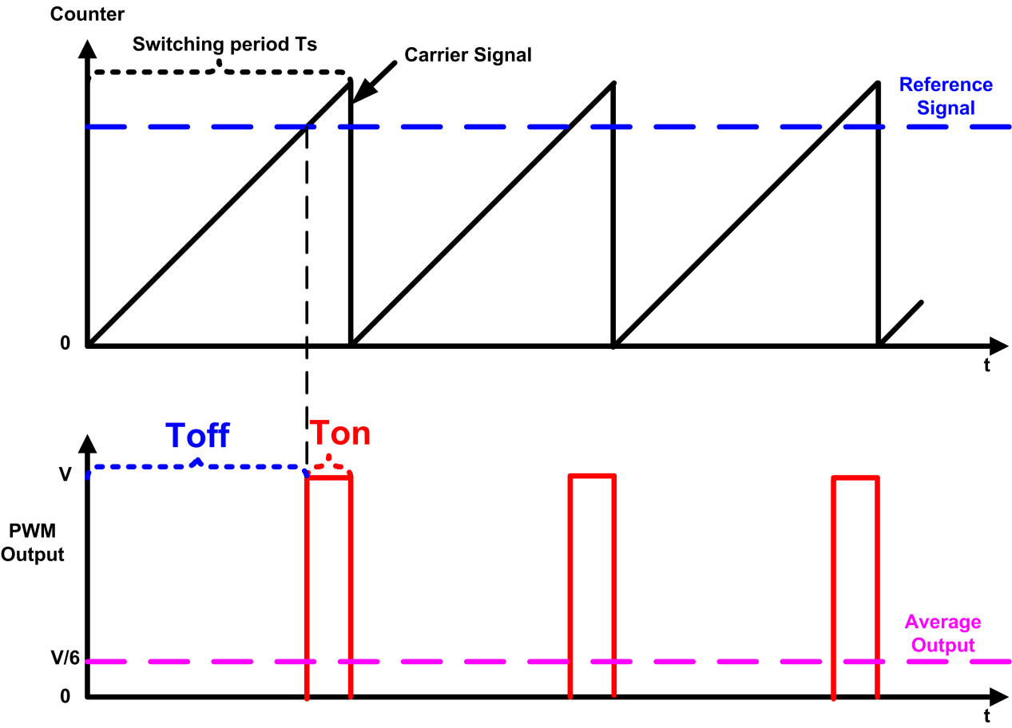
Lab 1: PWM Output
Register-level programing a GPIO pin and a timer
Generate a PWM signal with fixed duty ratio and frequency
References:
  TrueStudio IDE installation tutorials
  Download TrueStudio Project from github
    Public students’ version
    Private teachers’ version
  Textbook
  STM32F401xC Reference Manual

Slide 24
Lab 1: PWM Output
CN1
STC4054
LD39015
P8
M4
M2
M3
M1
LDO
3V3
SPBTLE-RF
JTAG connector
Micro USB **
Battery charger
BLE module
LiPo 1-cell battery
32-bit MCU
BT1
SPI1
USB
JTAG
LSM6DSL
A + G IMU
SPI2
TIM4 PWM out
Power MOS x4
4 x DC motor
LIS2MDL
Magnetometer
STL6N3LLH6
P1, P2, P4, P5
TIM2 input capture
PWM
Remocon RX*
LPS22HD
Pressure Sensor
P6
UART connector
UART1
I2C2
I2C connector
P7
STM32F401
P3

Slide 25
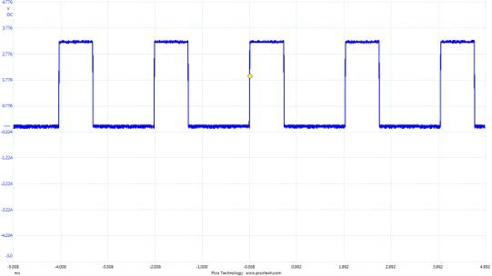
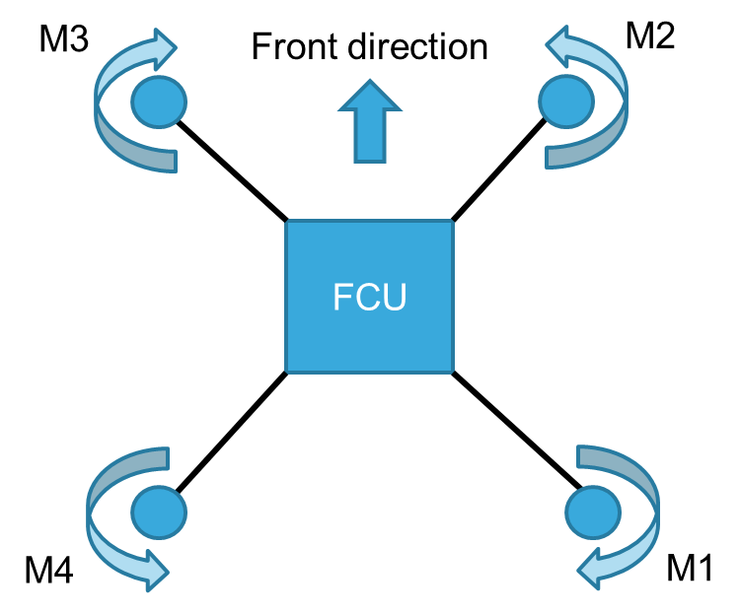
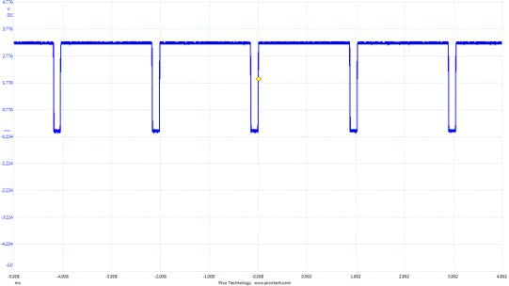
Controller
THR = Min
THR = Max
CW: Blue(-)/Red(+)
CCW: Black(-)/White(+)
Motor control connector PWM signal on pin 2 (or P1, P2, P4, P5) with THR to min. value and to max. value

Slide 26
Lab 1: PWM Output
Pre-Lab

Slide 27
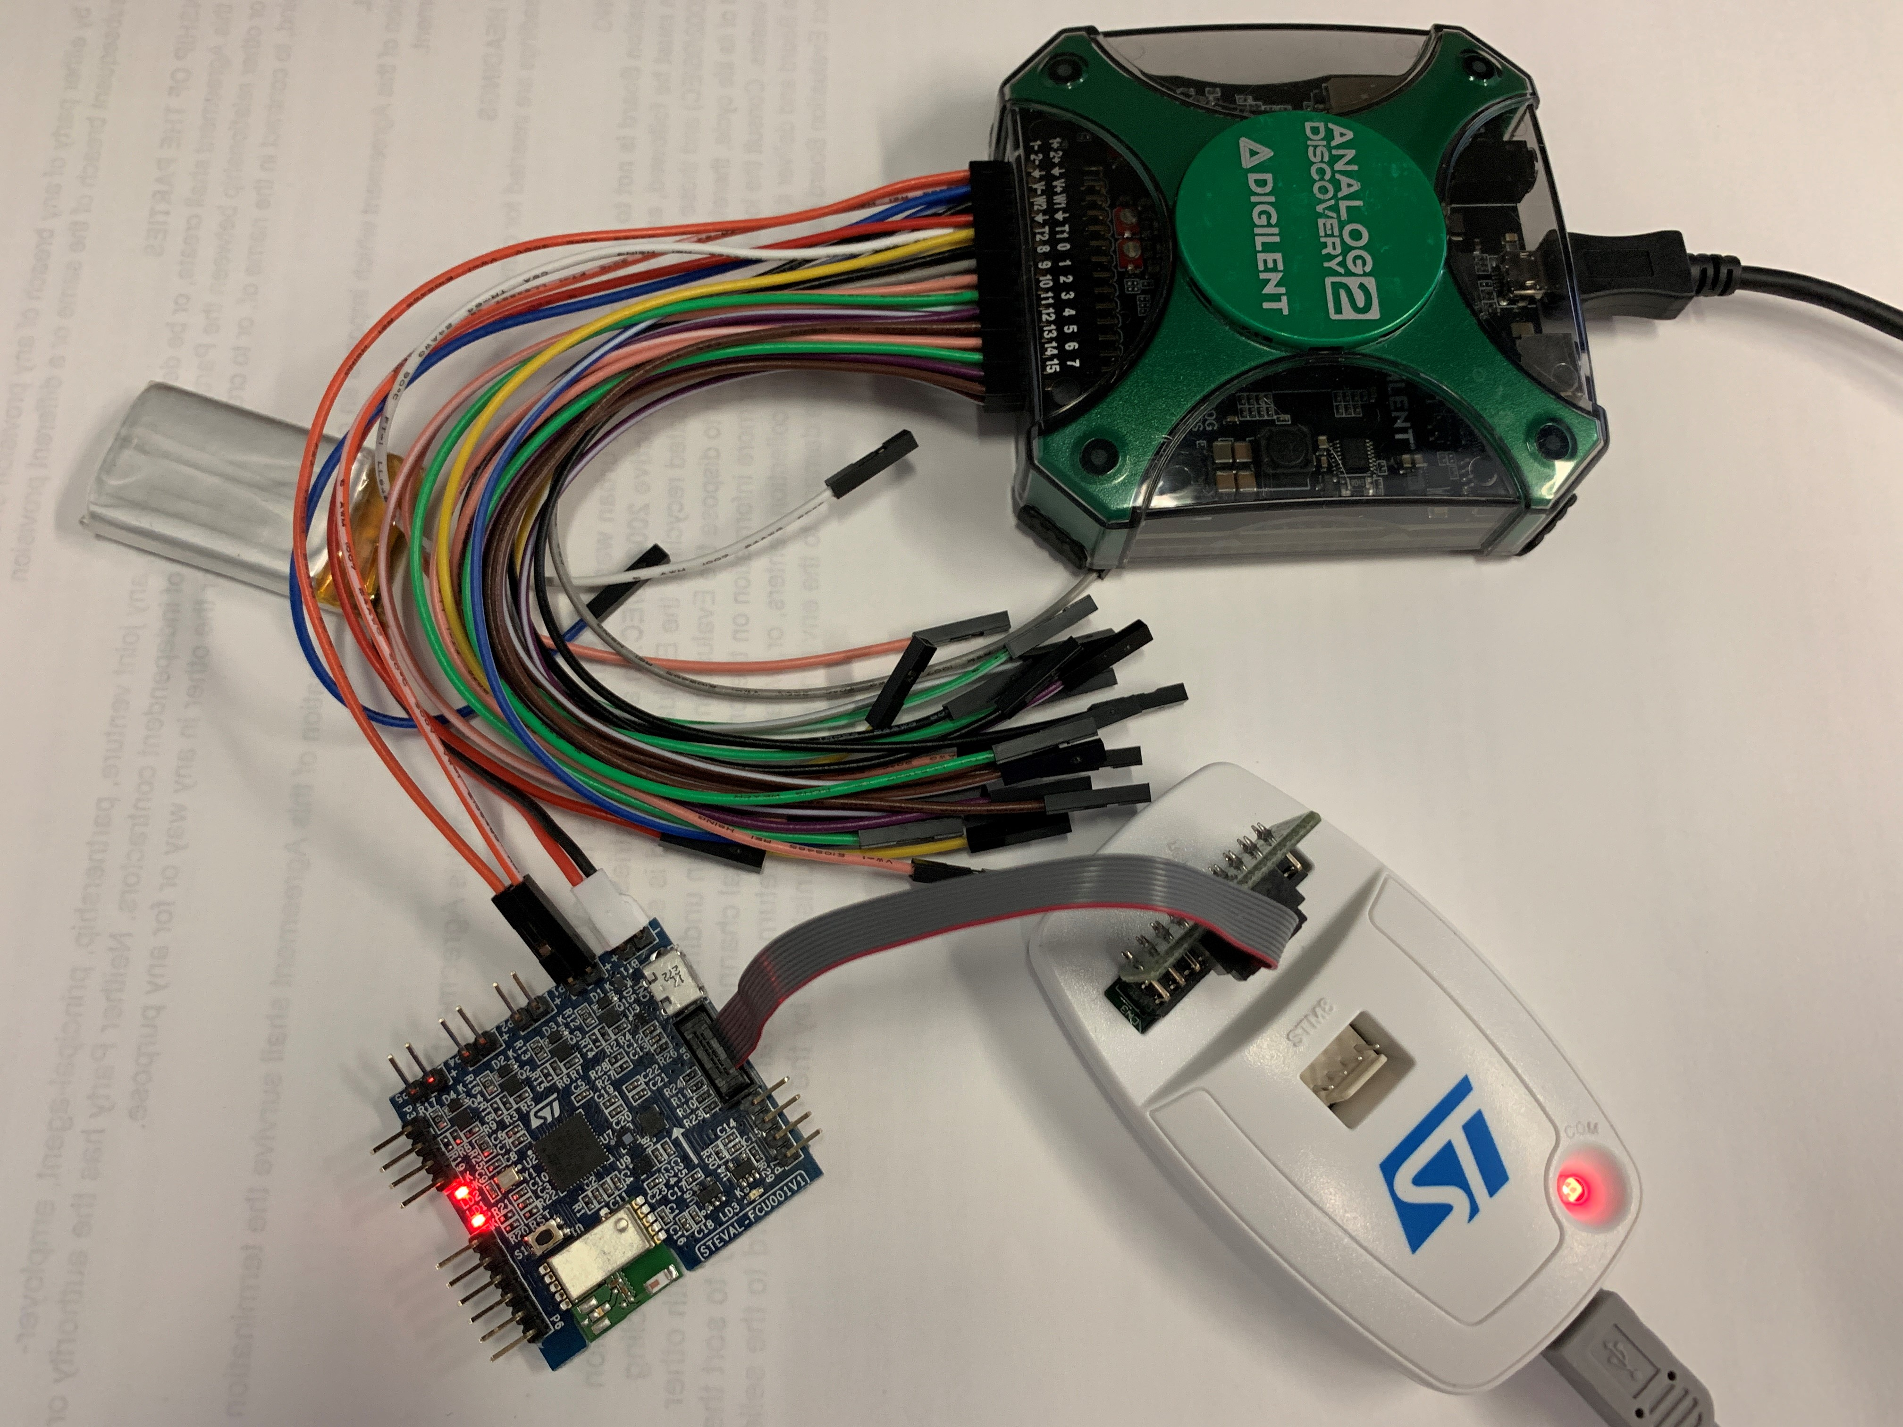
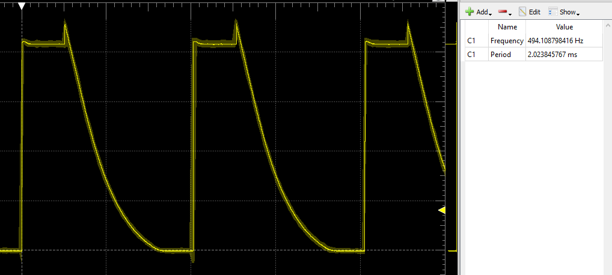
Lab 1: PWM Output
Lab coding & Demo
25% Duty Cycle, 494 Hz

Slide 28
Lab 1: PWM Output
Post-lab
Suppose the 16-MHz HSE (high-speed external clock) is selected as the input clock of timer 1. Answer the following questions and show your calculation process clearly. Write your answer in README.md and submit it to gitlab.
To generate 1 Hz square wave with a duty cycle of 50%, how should we set up the timer? Indicate your counting mode and show the value of ARR, CRR, and PSC registers.
What is the smallest PWM frequency that can be generated?

Slide 29
Lab 2: UART
CN1
STC4054
LD39015
P8
LDO
3V3
SPBTLE-RF
JTAG connector
M4
M2
M3
M1
Micro USB **
Battery charger
BLE module
LiPo 1-cell battery
32-bit MCU
BT1
SPI1
USB
JTAG
LSM6DSL
A + G IMU
SPI2
TIM4 PWM out
Power MOS x4
4 x DC motor
LIS2MDL
Magnetometer
STL6N3LLH6
P1, P2, P4, P5
TIM2 input capture
PWM
Remocon RX*
LPS22HD
Pressure Sensor
P6
UART connector
UART1
I2C2
I2C connector
P7
STM32F401
P3

Slide 30
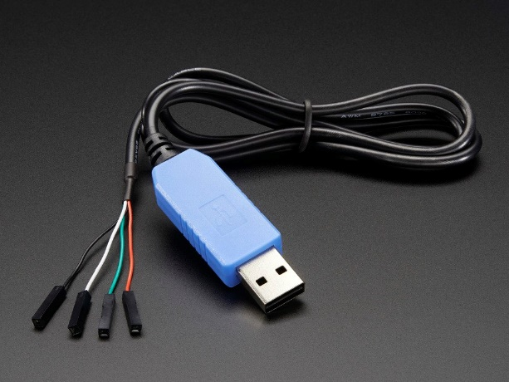
Lab 2: UART Pre-lab
UART can be used to display debug information on PC
Register-level programming
USB to TTL Serial Cable

Slide 31
Lab 2: UART
Basic Requirements:
  Polling for sending and receiving
For advanced courses
  Interrupts
  DMA
for (i = 0; i < nBytes; i++) {
// Wait until TXE (TX empty) is set
// Writing USART_DR automatically clears the TXE flag
while (!(USARTx->SR & USART_SR_TXE));
USARTx->DR = (buffer[i] & 0xFF);
}

Slide 32
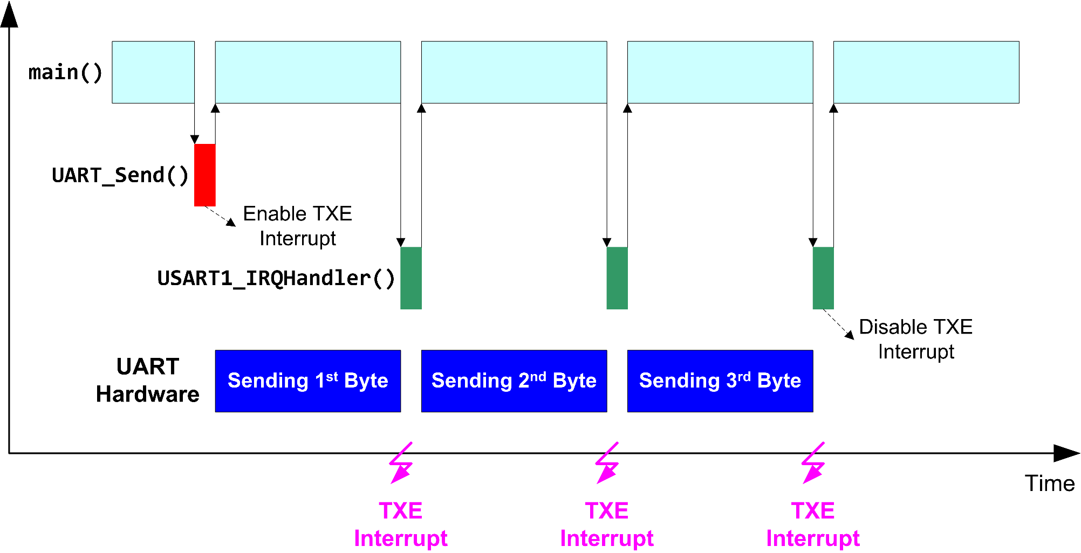
Lab 2: UART
Basic Requirements:
  Polling for sending and receiving
For advanced courses
  Interrupts
  DMA

Slide 33
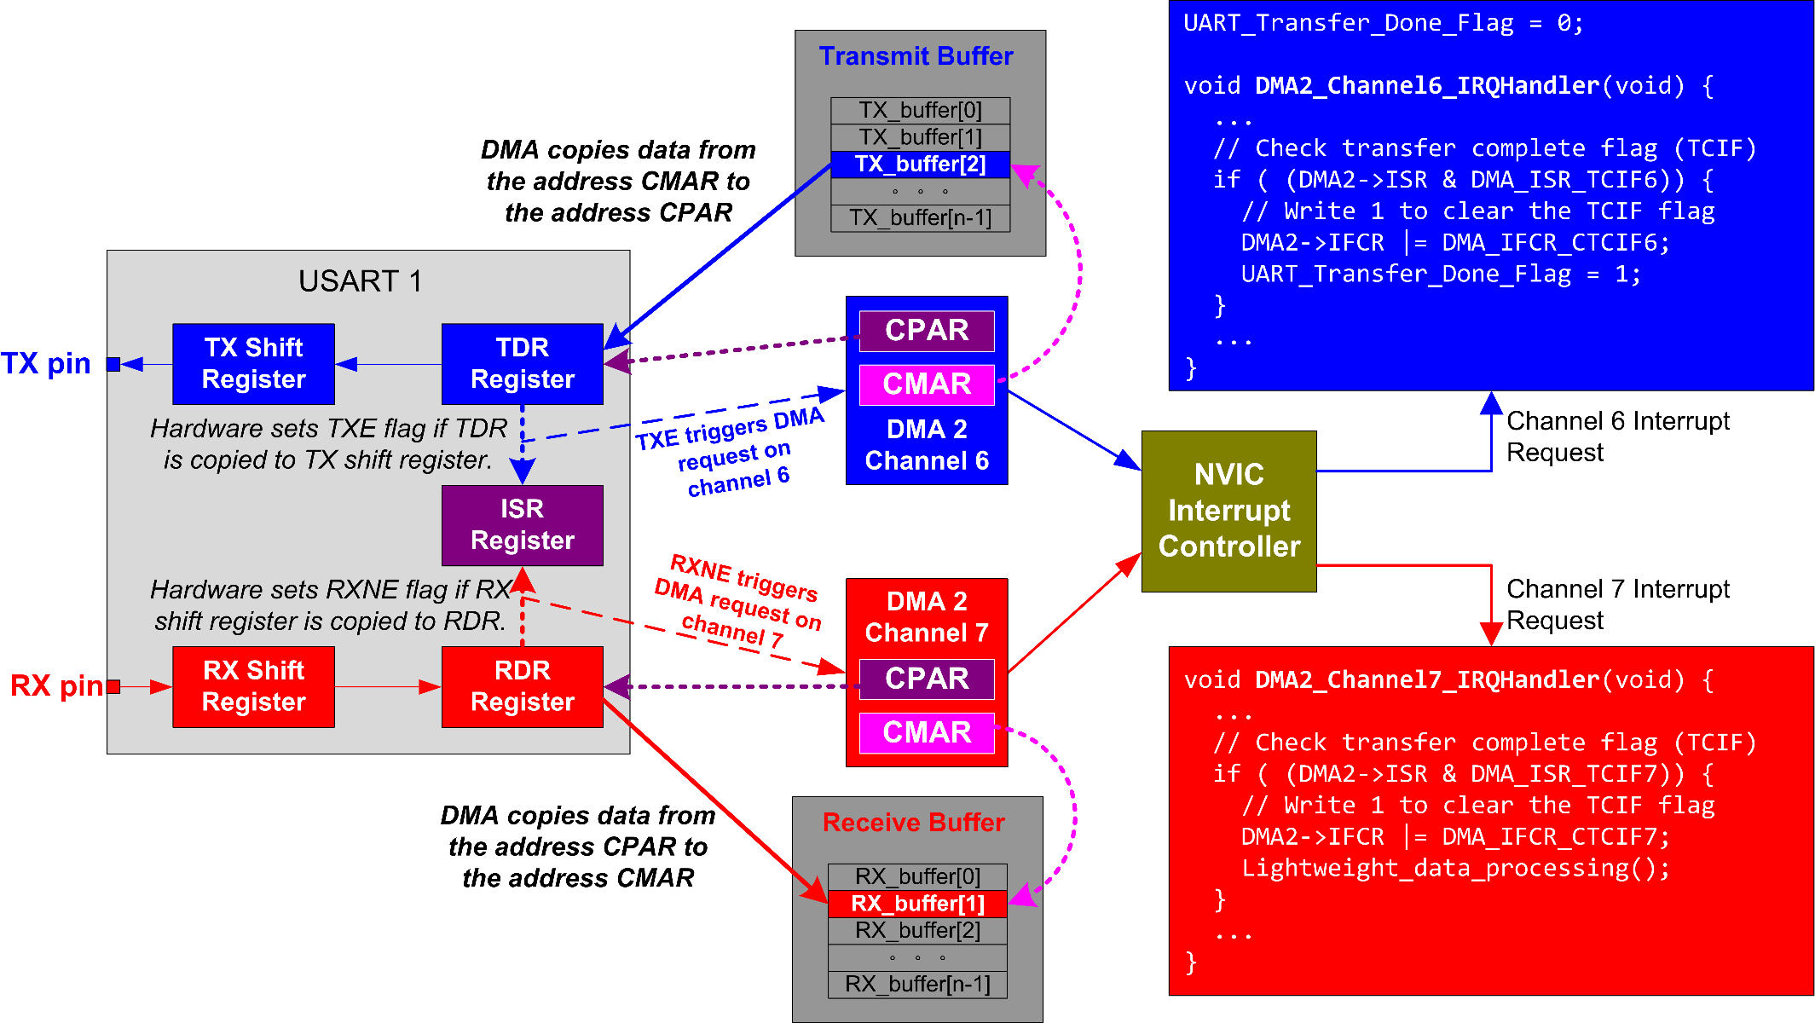
Lab 2: UART
Basic Requirements:
  Polling for sending and receiving
For advanced courses
  Interrupts
  DMA

Slide 34
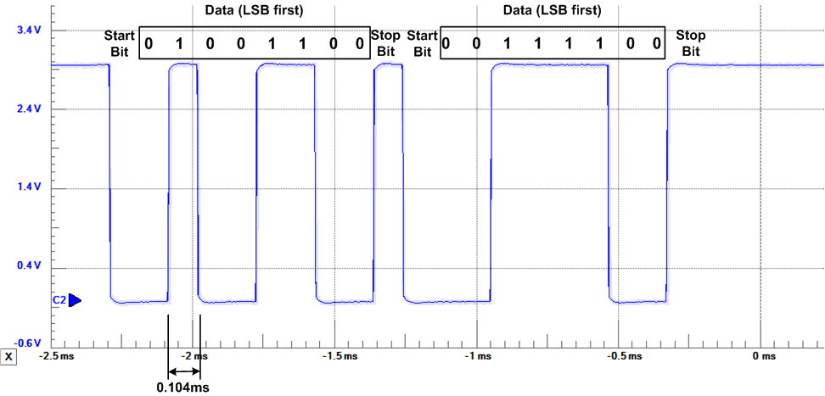
Lab 2: UART Post-lab
Using oscilloscope or digital analyzer or oscilloscope to analyze signals sent
1 start bit, 1 stop bit, 8 data bits, no parity, baud rate = 9600

Slide 35
Lab 3: ADC
Measure battery voltage level
Send measurements to PC via UART
Independent of Lab 2
x(t)
x(n)
ADC
quantize
continuous-time analog signal
discrete-time digital values

Slide 36
Lab 3: ADC
Main program
Basic Requirements:
  Constantly polling
  Polling with timer
Advanced
  Interrupts
  DMA
Wait for ready flag in ADC ISR
Process Data
Repeat

Slide 37
Lab 3: ADC
Main program
Basic Requirements:
  Constantly polling
  Polling with timer
Advanced
  DMA
ADC interrupt
Set up timer
timer interrupt
Timer
Peripheral
ADC
Peripheral
Timer ISR
Wait for ADC_Done = 1
Set ADC_Done flag
ADC ISR
Process Data
ISR = Interrupt Service Routine
TIMER ISR starts ADC
ADC samples multiple channels
ADC ISR copies ADC data register to memory
Repeat

Slide 38
Lab 3: ADC
Main program
Basic Requirements:
  Constant Polling
  Polling with timer
Advanced
  DMA
Set up DMA
Set up timer
timer interrupt
sampling
channels
DMA
Controller
Timer
Peripheral
ADC
Peripheral
Timer ISR
Wait for DMA_Done = 1
Set DMA_Done flag
Process Data
Timer ISR starts ADC and DMA
DMA automatically copies ADC results of multiple channels to memory after each conversion
Repeat

Slide 39
Lab 4: SPI
CN1
STC4054
LD39015
P8
M4
M2
M3
M1
LDO
3V3
SPBTLE-RF
JTAG connector
Micro USB **
Battery charger
BLE module
LiPo 1-cell battery
32-bit MCU
BT1
SPI1
USB
JTAG
LSM6DSL
A + G IMU
SPI2
TIM4 PWM out
Power MOS x4
4 x DC motor
LIS2MDL
Magnetometer
STL6N3LLH6
P1, P2, P4, P5
TIM2 input capture
PWM
Remocon RX*
LPS22HD
Pressure Sensor
P6
UART connector
UART1
I2C2
I2C connector
P7
STM32F401
P3

Slide 40
Lab 4 SPI
Sensor driver
  steval_fcu001_v1_accelero.c
  steval_fcu001_v1_gyro.c
  steval_fcu001_v1_magneto.c
  steval_fcu001_v1_pressure.c
Register-level programming assignments
  Sensor_IO_SPI_CS_Init_All(void)
  Sensor_IO_SPI_Init(void )
32-bit MCU
LSM6DSL
A + G IMU
SPI2
LIS2MDL
Magnetometer
LPS22HD
Pressure Sensor
STM32F401

Slide 41
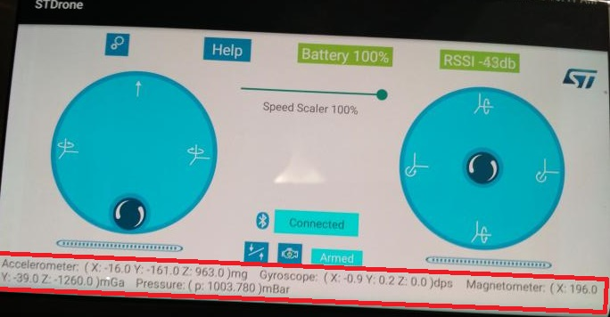
Lab 4 SPI
Lab Demo

Slide 42
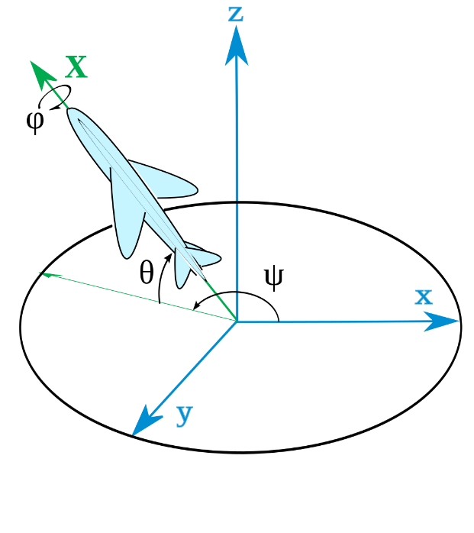
Lab 5: AHRS
Attitude and heading reference system (AHRS)
Conversion between Quaternions and Euler Angles
Calculate orientation of an object by using accelerometer and gyroscope
Notes:
Euler angles are more human understandable and also good for decomposing rotations into individual degrees of freedom. Quaternions are more computationally efficient. You have to make three rotations and multiply them together when rotating by Euler angles, whereas a Quaternion is only one rotation and as it already encodes the sin and cos, the conversion from quaternion to matrix is quite efficient.
There's an ambiguity in the specification of Euler angles: which angle applies to which axis? Code that uses the convention (yaw, pitch, roll) won't interoperate with code that assumes (roll, pitch, yaw), and it may not be obvious, from looking at the code, which interpretation is being used.
Quaternions don't suffer from this ambiguity, since they only represent a single rotation, with a well-defined axis.

Slide 43
Lab 5: AHRS
Attitude and heading reference system (AHRS)
Conversion between Quaternions and Euler Angles
Calculate orientation of an object by using accelerometer and gyroscope
IIR filter
FIFO_Order 5
Sensor data updated
@800Hz
Acc data
Static calibration
Low-pass filter
fc = 30Hz
Averaging every 5 samples
AHRS
@160Hz
gyro data
main.c
ahrs.c
Sensor_data.c
Pressure sensor and magnetometer are not used currently.

Slide 44
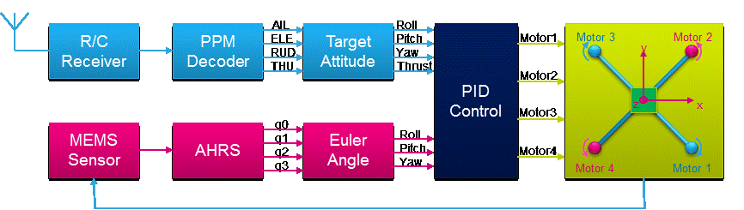
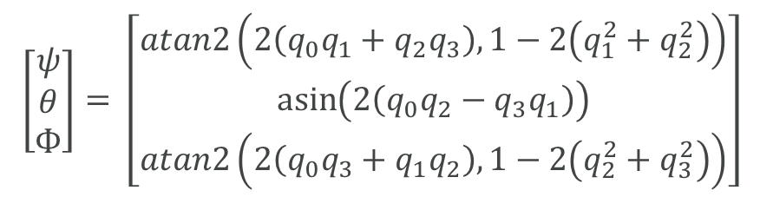
Lab 5: AHRS
$$\left[\begin{matrix}ψ \\ θ \\ Ф\end{matrix}\right]= \left[\begin{matrix}atan2\left(2\left(q_{0}q_{1}+q_{2}q_{3}\right), 1−2\left(q_{1}^{2}+q_{2}^{2}\right)\right) \\ \operatorname{asin}\left(2\left(q_{0}q_{2}−q_{3}q_{1}\right)\right) \\ atan2\left(2\left(q_{0}q_{3}+q_{1}q_{2}\right), 1−2\left(q_{2}^{2}+q_{3}^{2}\right)\right)\end{matrix}\right]$$
ψ/θ/Ф are the yaw/pitch/roll

Slide 45
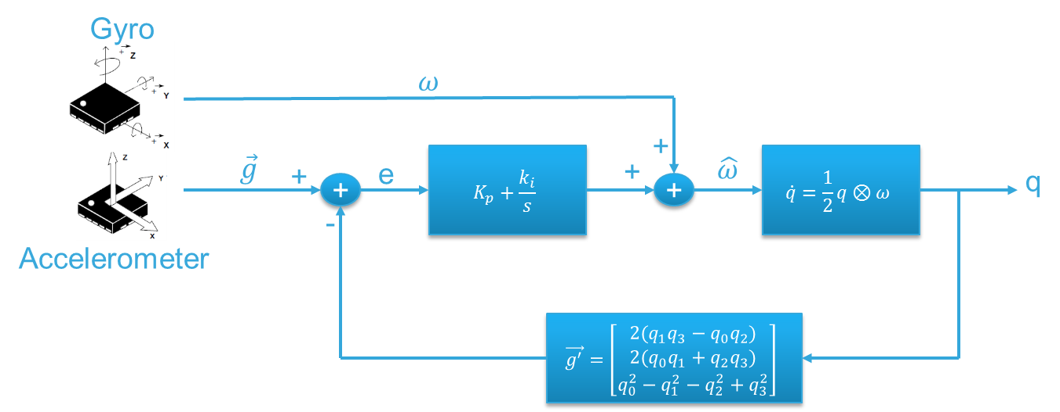
Lab 5: AHRS
  Accelerometer and gyroscope can calculate the attitude independently.
  Accelerometer is always influenced by high-frequency noise, and gyroscope has a low-frequency offset.
  Gyroscope results are accurate in short-term, but will generate an offset over time. Acc is not accurate in short-term because of noise, but is reliable over time.

Slide 46
Lab 5: AHRS
Focus on understanding the concepts
  Conversion between Quaternions and Euler Angle
  Calculating the orientations by using gyroscope and accelerometer measurements
Example lab assignment
  Given constant gyroscope and accelerometer measurements
  Calculate and plot the orientation over the time

Slide 47
Lab 6: PID

Slide 48
Lab 6: PID
R/C
Receiver
Target Attitude
@50Hz
rc.c
IIR filter
FIFO_Order 5
Sensor data updated
@800Hz
Acc data
Static calibration
Low-pass filter
fc = 30Hz
Averaging every 5 samples
AHRS
@160Hz
PID outer loop
@160Hz
gyro data
Sensor_data.c
Main.c
ahrs.c
Flightcontrol.c
PID inner
Loop
@800Hz
M1 = Th – P – R + Y
M2 = Th + P – R – Y
M3 = Th + P + R + Y
M4 = Th – P + R – Y
Th = Thrust, P = Pitch
R = Roll, Y = Yaw
PWM generator
motors
Flightcontrol.c
Blocks in bolds are the Key ones for stabilization and anti-drifting.

Slide 49










Lab 6: PID
$$θ_{x}(RC)$$
+
$$θ_{y}(RC)$$
+
PID
Outer loop
+
PID Inner loop
$$θ_{z}(RC)$$
+
+
-
-
Pitch
$$θ_{x}(AHRS)$$
$$ω_{x}$$
Roll
$$θ_{y}(AHRS)$$
$$Gyro$$
$$ω_{y}$$
Yaw
$$θ_{z}(AHRS)$$
$$ω_{z}$$
PID control is performed in two separate stages:
PID Outer loop: comparing the target Euler angles given by Remocon and the Euler angles of the AHRS system, it controls the incline angle
PID Inner loop: used to track the angular rate.
Using a mathematical model of the drone system, it is almost impossible to make the system stable in a single loop. The inner loop has to be added to the outer loop in order to stabilize the system. The relative functions are present in flight_control.c:

Slide 50







Lab 6: PID
M1 = Thrust – PID_Pitch – PID_Roll + PID_Yaw
M2 = Thrust + PID_Pitch – PID_Roll – PID_Yaw
M3 = Thrust + PID_Pitch + PID_Roll + PID_Yaw
M4 = Thrust – PID_Pitch + PID_Roll – PID_Yaw
+
PID
Pitch
$$θ_{x}(RC)$$
$$θ_{x}(AHRS)$$
M1
PID
Roll
M2
$$θ_{y}(RC)$$
+
M3
M4
$$θ_{y}(AHRS)$$
+
PID
Yaw
$$ω_{z}(RC)$$
$$ω_{z}(AHRS)$$
Thrust
$$Th(RC)$$

Slide 51
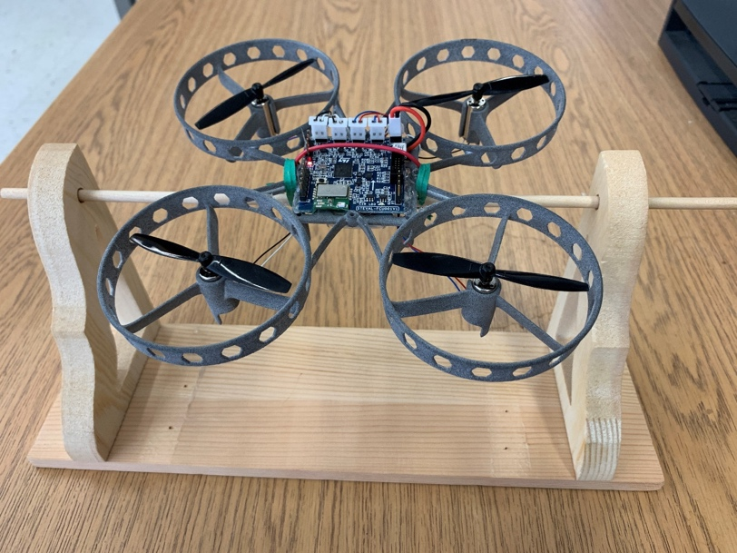
Lab 6: PID
Study the impact of the PID control parameters to a drone in a restrained setting

Slide 52
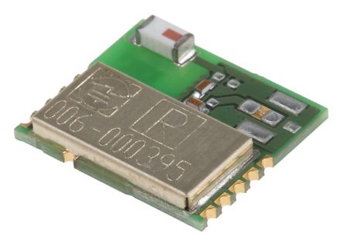
Lab 7: BLE
CN1
STC4054
LD39015
P8
LDO
3V3
SPBTLE-RF
JTAG connector
Micro USB **
Battery charger
BLE module
LiPo 1-cell battery
32-bit MCU
BT1
SPI1
USB
JTAG
LSM6DSL
A + G IMU
SPI2
TIM4 PWM out
Power MOS x4
4 x DC motor
LIS2MDL
Magnetometer
STL6N3LLH6
P1, P2, P4, P5
TIM2 input capture
PWM
Remocon RX*
LPS22HD
Pressure Sensor
P6
UART connector
UART1
I2C2
I2C connector
P7
STM32F401
P3
Notes:
The is a single-mode Bluetooth low energy master/slave network processor module compliant with Bluetooth® v4.1.

Slide 53
Lab 7: BLE
Host
Generic Attribute Profile(GATT)
  defines how data is organized and exchanged
Attribute Protocol (ATT)
  allows the device to say what certain pieces of data are
  defined by a 16-bit universally unique identifier (UUID)
Security Manager(SM)
  encryption and authentication
Logical Link Control and Adaptation Protocol(L2CAP)
  encapsulate into the standard BLE packet format
Host Controller Interface(HCI)
Link Layer (LL)
Physical Layer(PHY)
GATT/ATT/SM
L2CAP
HCI
SPI/UART/USB/SDIO
Controller
GATT/ATT/SM
L2CAP
HCI
Notes:
A typical BLE system consists of an LE controller and a host. The LE controller consists of a physical layer (PHY) including the radio, a link layer (LL) and a standard host controller interface (HCI). The host consists of a HCI and other higher protocol layers, e.g. L2CAP, SM, ATT/GATT, GAP etc.
In many designs the LE controller and the host reside in two separate silicon chips and are controlled by 2 different microcontrollers. Communication between the two is transmitted via a hardware connection, e.g. UART, SPI, USB, etc. The host can send HCI commands to control the LE controller. The HCI interface and the HCI commands are standardized by the Bluetooth core specification. Please refer to the official document for more information.
Sometimes the LE controller and the host can be combined into a single chipset solution.

Slide 54
Lab 7: BLE
Application Control Interface (ACI)
  User applications send ACI commands to control the BLE controller over SPI
  ACI commands utilize and extend the standard HCI data format.
    HCI command packet
    HCI ACL data packet
    HCI synchronous data packet
    HCI event packet
Host
User Application
BLE Controller
Application Control Interface (ACI)
SPI
Application Control Interface
(ACI)
BLE Protocol Stack
Power Management
Memory Management
Radio Controller

Slide 55
Lab 7: BLE
tBleStatus Value_Update(uint16_t value1, int16_t value2) {
tBleStatus ret;
uint8_t BuffPos;
uint8_t buff[2+2+2]; //2 for tick value(2 bytes), 2 for value1(2 bytes), and 2 for value2(2 bytes)
STORE_LE_16(buff, (HAL_GetTick()>>3));
BuffPos=2;
STORE_LE_16(buff+BuffPos,value1);
BuffPos+=2;
STORE_LE_16(buff+BuffPos,value2);
BuffPos+=2;
ret = aci_gatt_update_char_value(HWServW2STHandle, EnvironmentalCharHandle, 0, 2+2+2,buff);//transmit data
if (ret != BLE_STATUS_SUCCESS){
return BLE_STATUS_ERROR;
}
return BLE_STATUS_SUCCESS;
}

Slide 56
Lab 8: Simple drone control

Slide 57
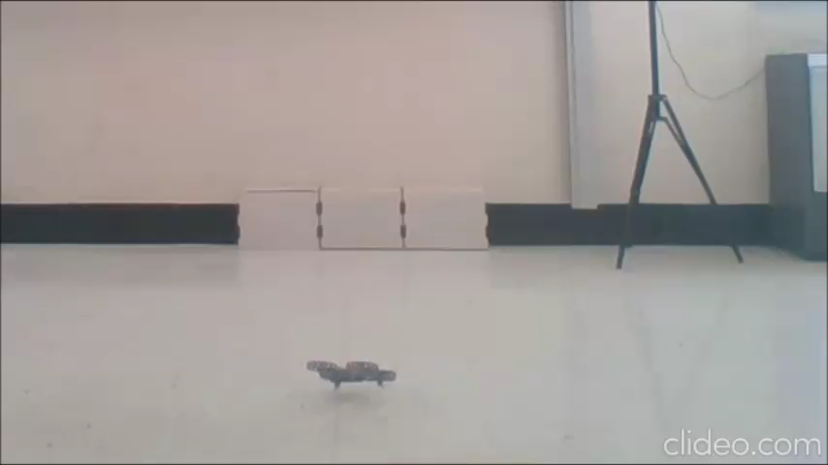
Lab 8: Simple drone control

Slide 58
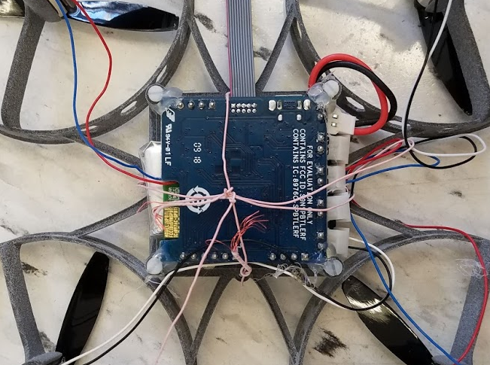
Lab 8: Simple drone control

Slide 59
Summary
Lab Materials
  Lab description
  Lab presentation
  Lab starting code for students
  Lab solutions for instructors
Eight lab modules:
  Register-level Programming
    PWM output
    UART
    ADC
    SPI
  Concept-level Understanding
    AHRS
    PID
    BLE
  Application-level Programming
    Flying

Slide 60
UAS Policy on Campus
Standard Operating Procedure for the Use of Unmanned Aerial Systems (UAS) on campus
  Make sure you have to compliance with the procedure if it exists
  It was simple for us for the ST drone kit. It was passed without formal applications and reviews.
  But always check with your safety and environment management office

Slide 61
For more information
Send email to Yifeng.Zhu@maine.edu for
  An exam copy of my book
  Complete instructor resources: slides, exams, quizzes, solutions, lab handouts & solutions
My book website: http://web.eece.maine.edu/~zhu/book/
  Sample labs, lab kit, FAQ
My YouTube Channel: https://www.youtube.com/channel/UCY0sQ9hpSR6yZobt1qOv6DA
Thank STMicroelectronics for organizing and sponsoring this workshop!

